Slide 1
Primary and Secondary Sources
An Overview

Slide 2
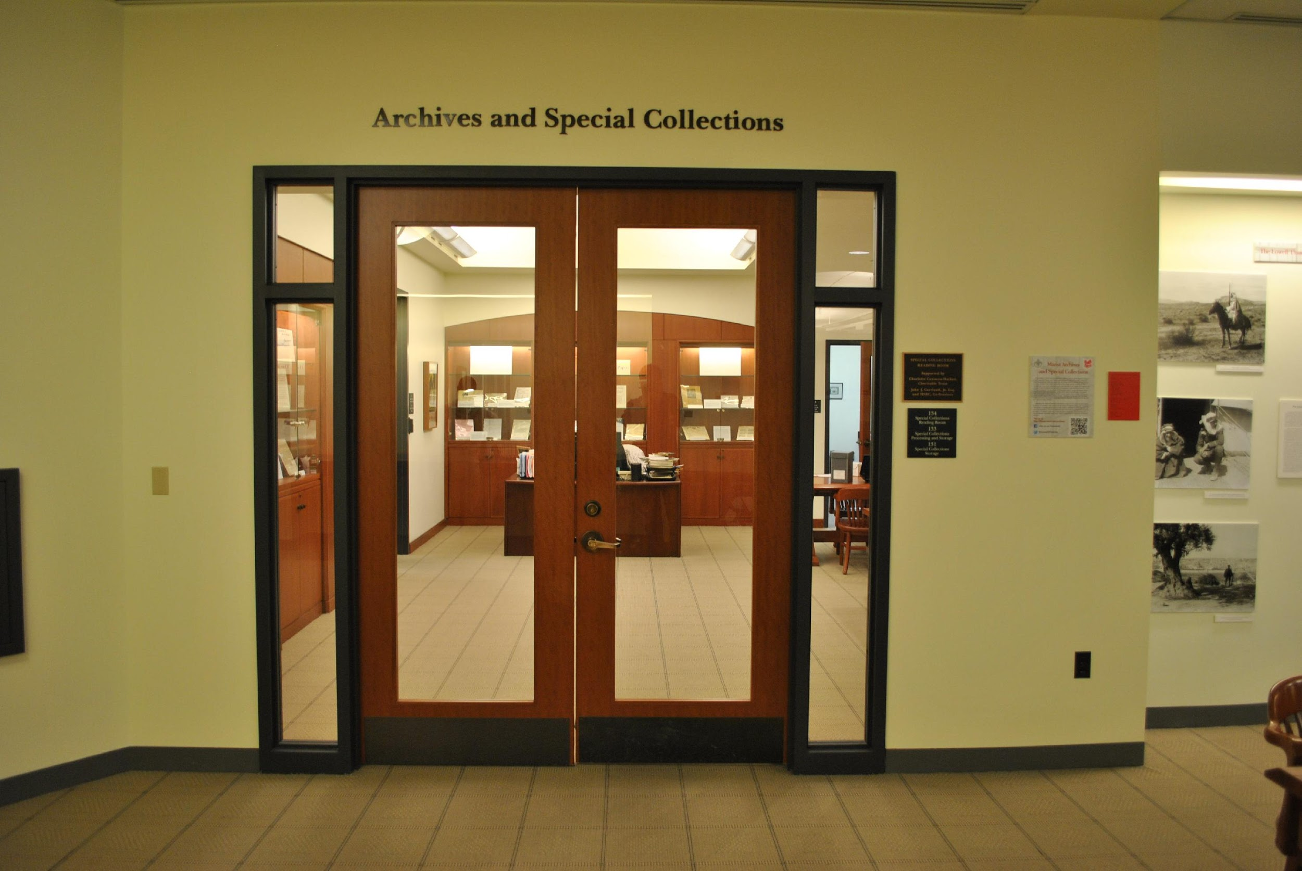
Archives and Special Collections – Located typically within University or Institution Libraries
Notes:
The Archives and Special Collections is located in the James A. Cannavino Library on the ground floor in room 134.

Slide 3
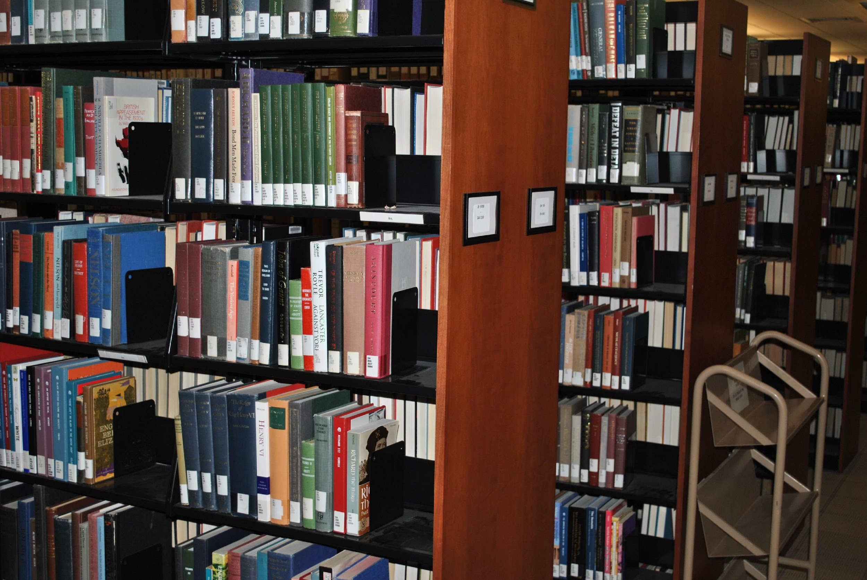
Library collections circulate, typically
Notes:
Unlike our regular circulating collection, where you can check out a book and take it home, our Special Collections can not be checked out.

Slide 4
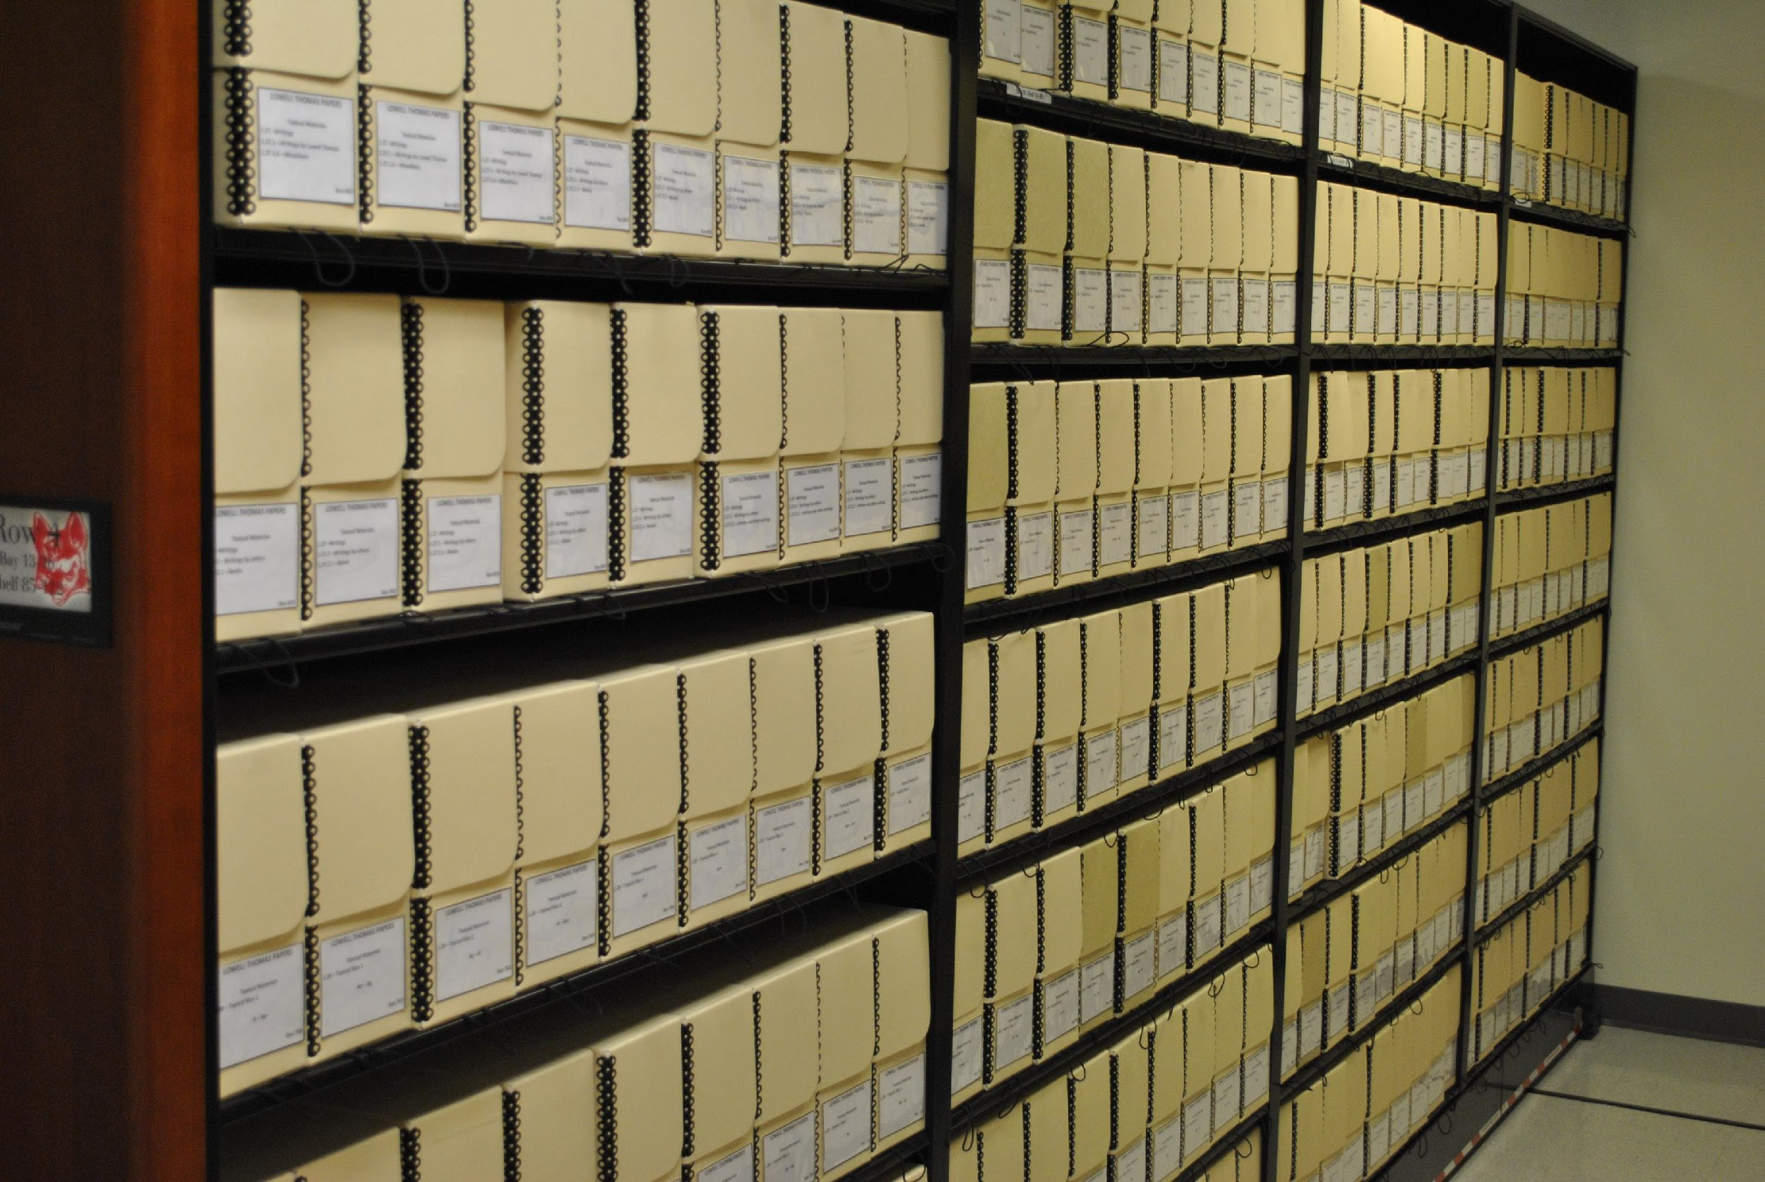
Archival collections never circulate
Notes:
In order to use materials from the College Archives or Special Collections, you need to request a box of materials using the tools on our website. Or, just ask us in the Archives, we are always happy to help!

Slide 5
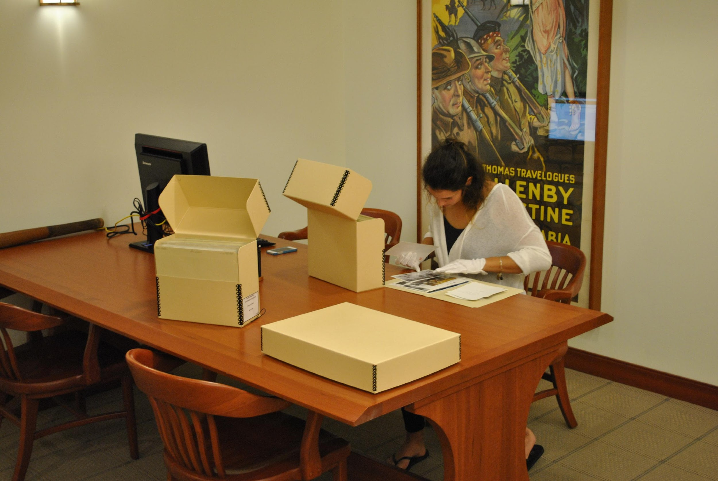
Archival collections are studied under supervision in a dedicated space
Notes:
We bring the collections out to you and you get to work with original materials in our Reading Room.

Slide 6
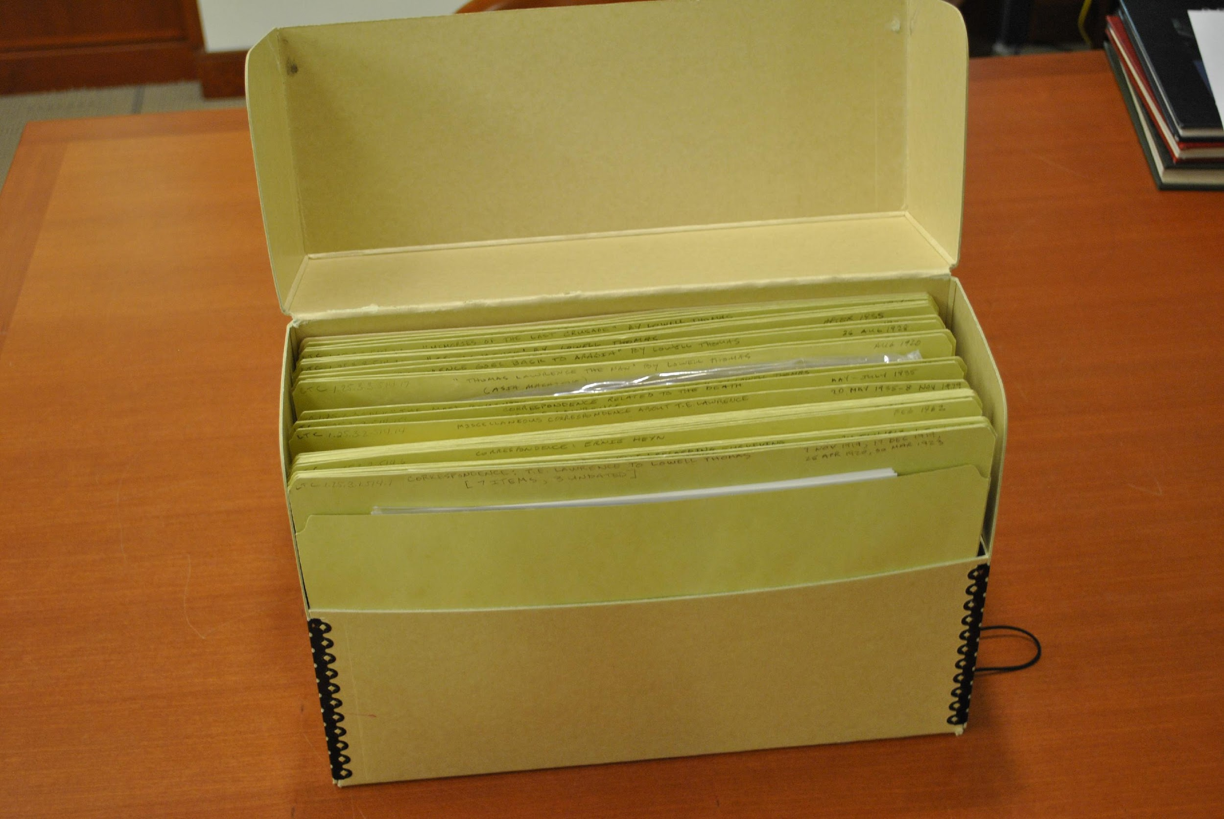
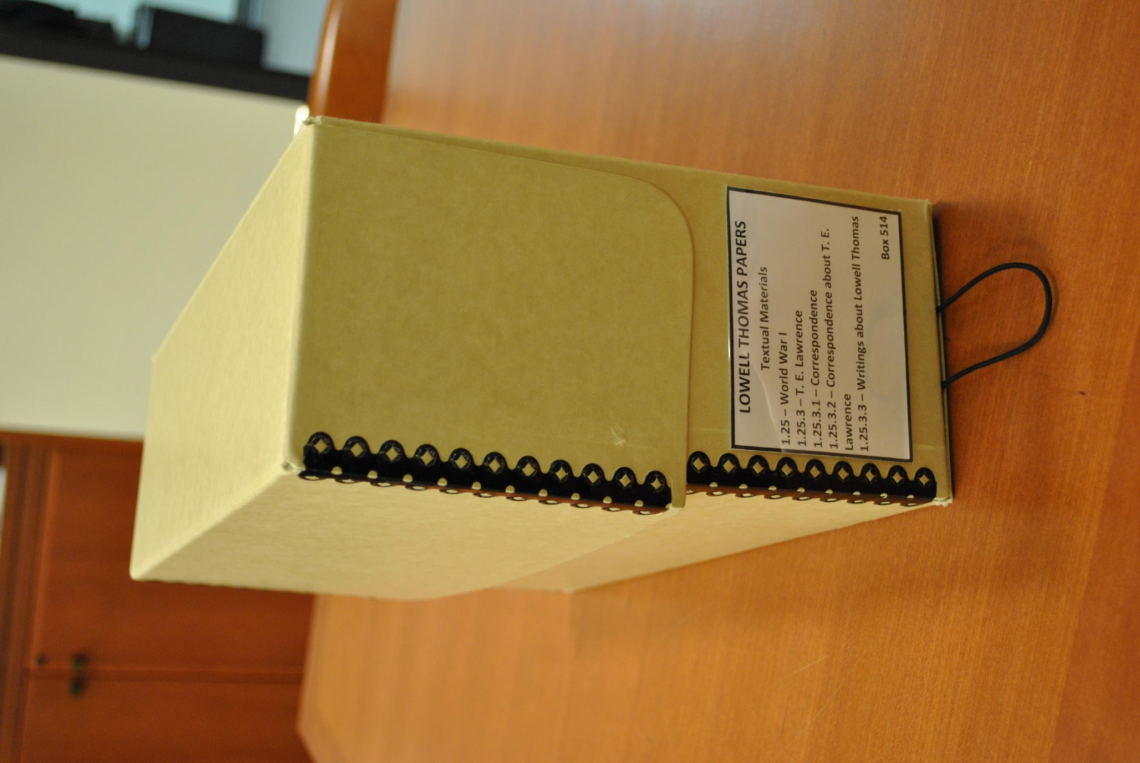
Collections will be brought out to you
Notes:
Unlike books, which are cataloged individually, special collections are cataloged down to a folder level. Beyond the folder description, you won’t know what is in a box until you open it! So, some background knowledge about your research is helpful, but you should also take the time to talk with the Archives’ staff to learn more about our collections.

Slide 7
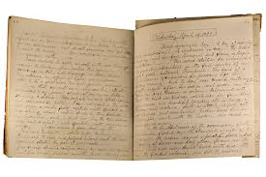
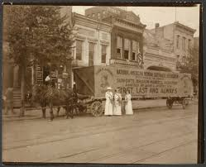
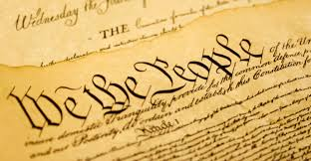
What is a primary source?
A primary source is an original object or document; first-hand information.
Primary source is material written or produced in the time period that you may be investigating.
Primary sources enable the researcher to get as close as possible to what actually happened during an historical event or time period.
Notes:
A primary source expresses a first-hand experience, impression, or idea.

Slide 8
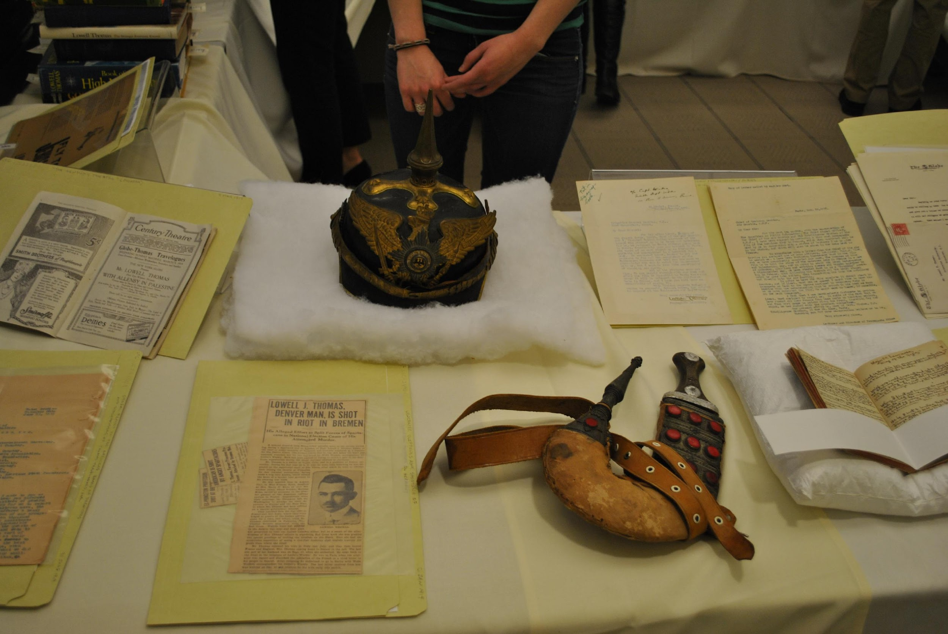
Primary sources can come in a variety of formats
Notes:
Primary sources can come in a variety of formats, such as letters, diaries, official documents, or interviews.

Slide 9
Primary Sources – Diaries and journals
Example: Anne Frank was a teenager during World War II. She kept a diary or journal the years before she died in a concentration camp. Her diary was later published as the Diary of Anne Frank. This is a primary source.
Example: Sarah Morgan was young woman during the Civil War. She wrote in her diary or journal what happened to her and her family during the war. This is a primary document because it was first hand. She wrote it at the time it happened.
Sarah Morgan Dawson: A Confederate Girl's Diary
Notes:
Keep in mind that all sources, not just primary sources, contain some sort of bias depending on the person’s background or agenda. Some are easier to detect than other. For example, one of President Franklin D. Roosevelt’s speeches may be trying to sway people to support one of his projects. All politicians do this. However, the bias may not be intentional on the creator’s part, but it is important as a researcher to understand the point of view of the person who created the primary source you are interpreting.

Slide 10
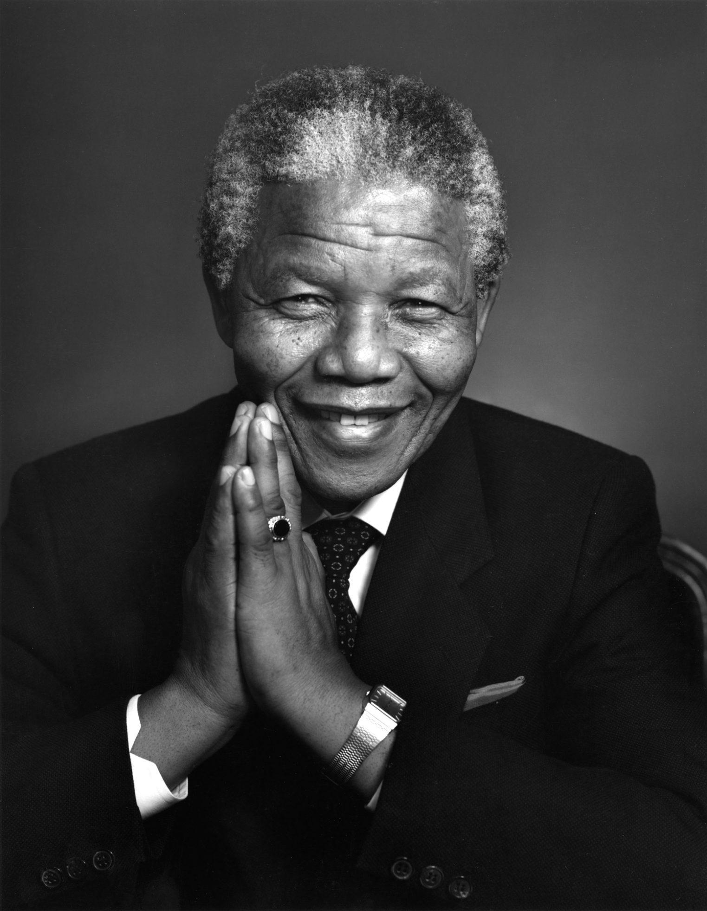
Primary Sources – Autobiographies
An autobiography is when you write a story or book about yourself.
Example: Nelson Mandela wrote his autobiography about events in his life called Long Walk to Freedom: The Autobiography of Nelson Mandela. This is a primary document because he wrote his first hand experiences.
Notes:
Remember, it is important to use multiple sources in your research. Relying too heavily on any one source will result in unbalanced, or even incorrect, interpretations and conclusions.

Slide 11
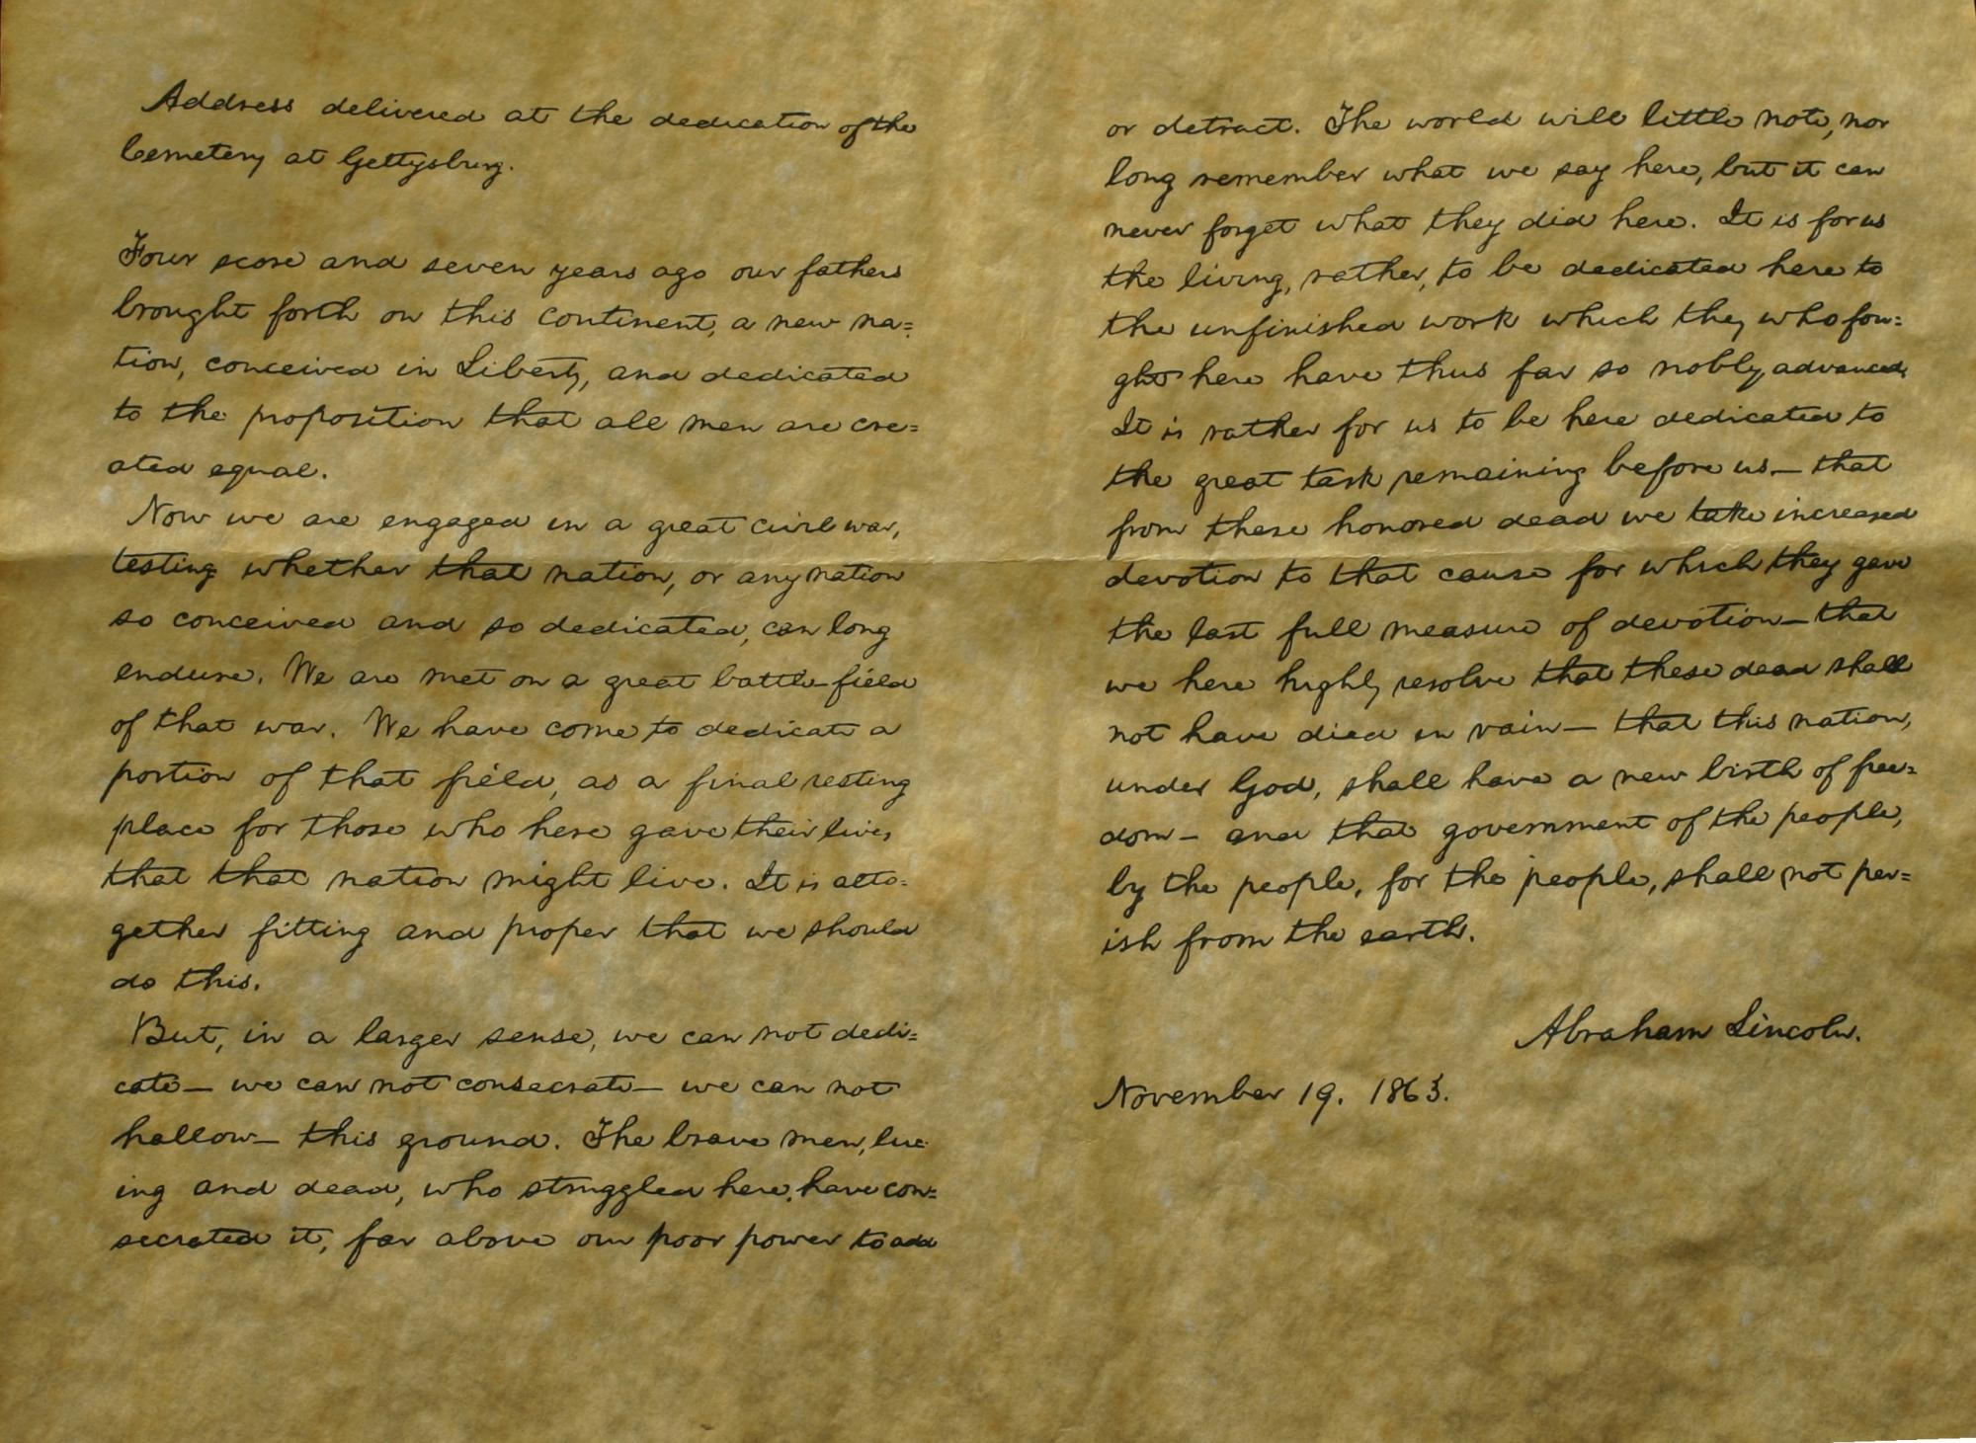
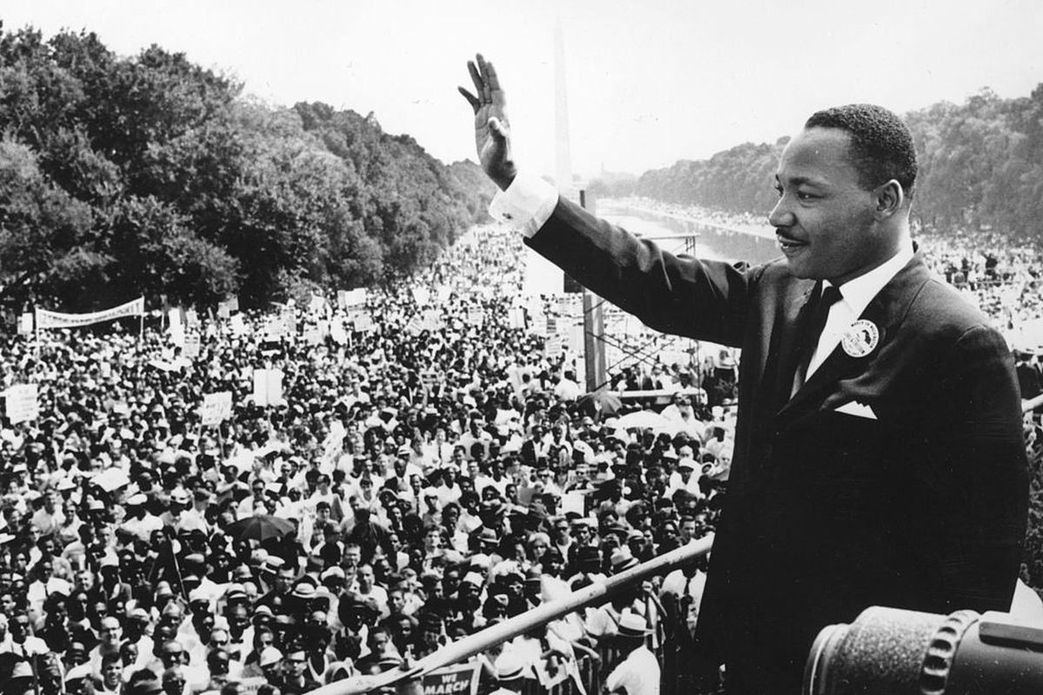
Primary Sources – Speeches
Examples of Speeches:
Abraham Lincoln’s “Gettysburg Address”
Martin Luther King’s “I Have a Dream”
All of the Presidents’ Inauguration Speeches
Notes:
Even official documents are considered primary sources, as long as they are giving a first hand account of an event.

Slide 12
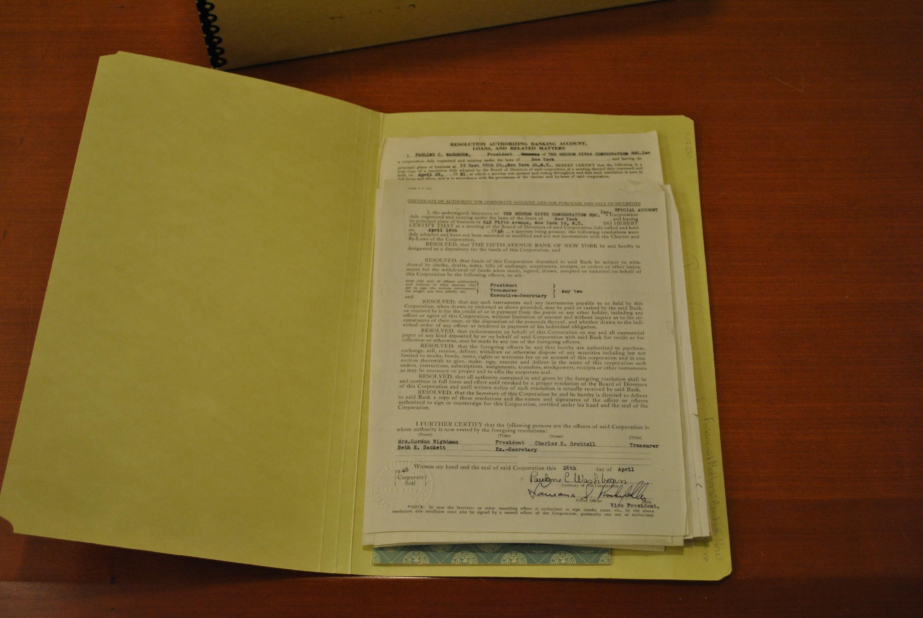
Primary Sources – Historical Documents
Historical documents such as the Declaration of Independence or the Constitution are primary documents. They were drafted and signed.
Other Primary Sources include:
Birth Certificates
Government records
Deeds
Court documents
Military records
Tax records
Census records
Works of art
Notes:
A wide range of primary resources can be found on-line, but keep in mind that only a small percentage of all primary resources have been digitized and made available on-line.

Slide 13
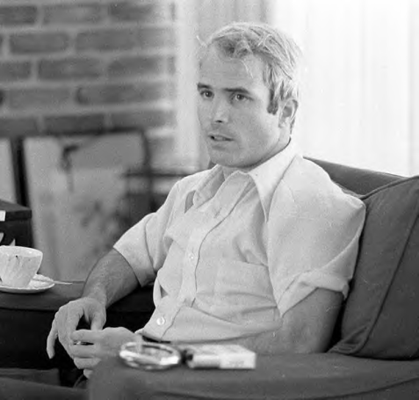

Primary Sources – Published first hand accounts or oral histories
Example: 2008 Presidential candidate Senator John McCain talked about his own experiences as a Vietnam prisoner of war. It is a primary source because he was there, experienced the events and shared it first hand.
The television stations found footage of Senator McCain at the time that he was released. Those videos are also considered primary sources because it was filmed when it occurred.
Notes:
It was only fairly recently, in the 1970s, that historians really began to accept oral histories as legitimate sources. The concern was that an individuals talking about personal experiences too long after an event occurred would not be accurate or memories would be influenced by more recent events. Ultimately, historians realized that oral histories are very useful resources, especially when used in conjunction with other sources.

Slide 14
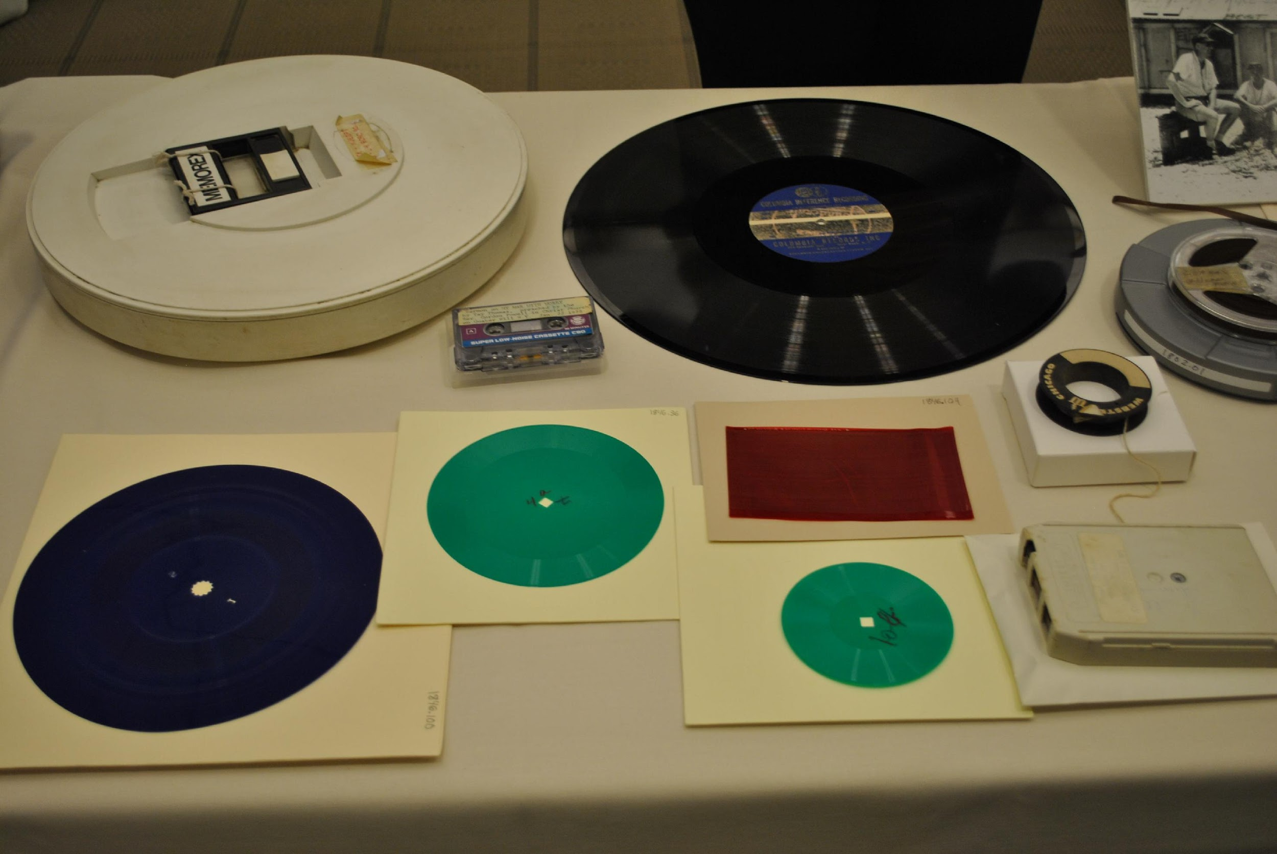
Primary Sources – Sound recordings and interviews
Example 1: During the Great Depression and World War II, television had not been invented yet. The people would often sit around the radio to listen to President Roosevelt’s war messages. Those radio addresses are considered primary sources.
Example 2: During the 2008 election Barack Obama, had many interviews that were televised. Those interviews are considered primary sources.
Notes:
Sound recordings and interviews can often be useful sources. Keep in mind that if you request a sound recording on an old audio format, it may take days, weeks, or even months to have the recording reformatted. So, you will need to plan your research time accordingly.
NOTE: Top row – early computer floppy disk, standard audio cassette, 16” phonograph record, wire recording, ¼” open reel audiotape. Bottom row – phonograph record, transcription disk, dictation loop (amber colored rectangle), small transcription disk (green disk), and an 8-track tape.

Slide 15
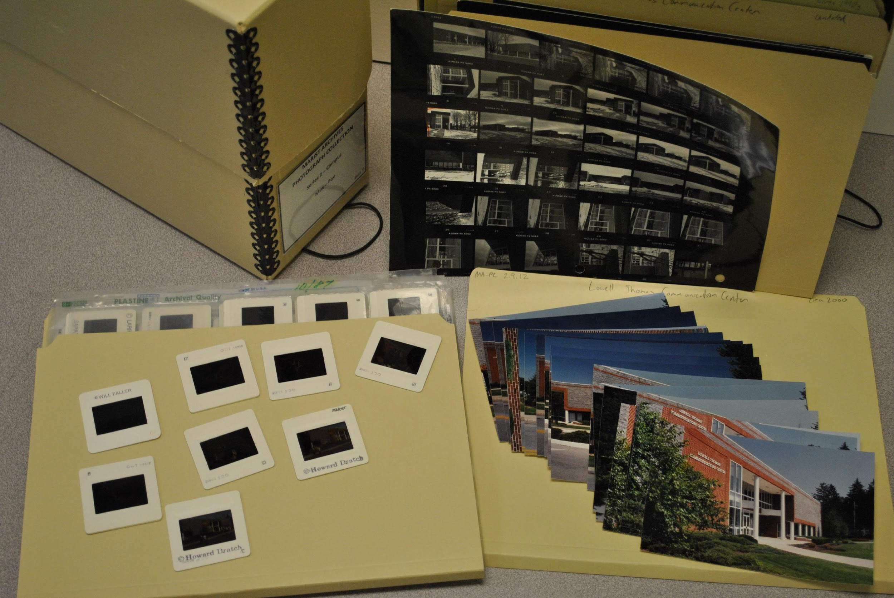
Primary Sources – Photos and videos
Example 1: Photographers during World War II took photographs of battles and/or events during the war. Those photographs are primary sources. Those were taken during actual events.
Example 2: The same holds true for videos or film created during an event. A film was made interviewing President Bush. That film would be considered a primary source.
Notes:
Other non-print sources, such as photos, can add a lot of useful information to your research.
NOTE: You can use old photo or audio formats as an opportunity to ask students if they know what is on the screen. Left – 35mm slides, Top – proof sheet, Right – standard 4” x 6” color prints.

Slide 16
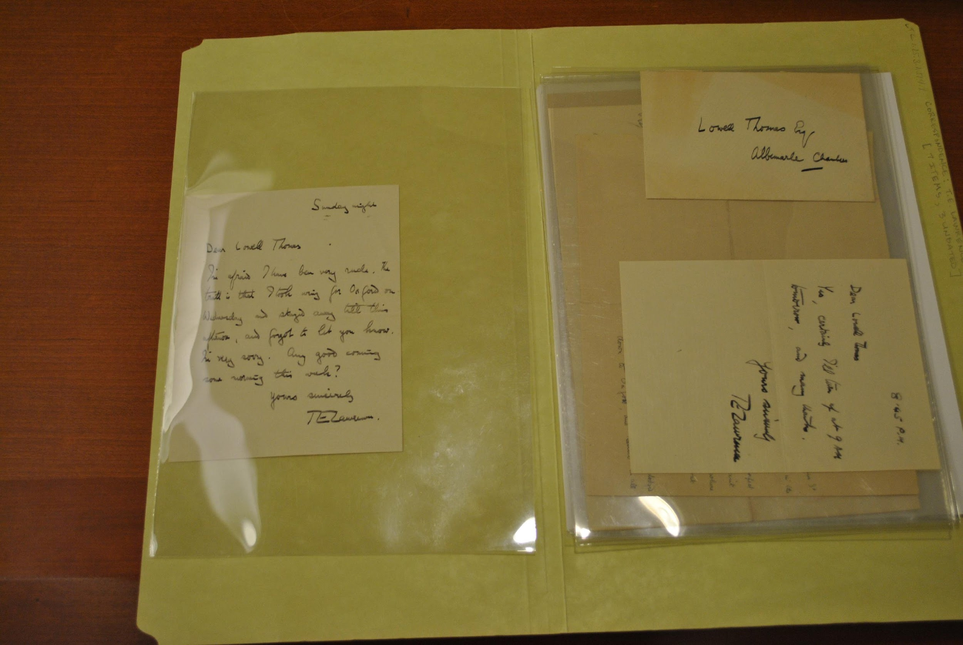
Primary Sources – Letters or correspondence
Example: Soldiers during wars wrote to their families about war events they experienced. Those letters are considered primary sources.
Example: T.E. Lawrence wrote to Lowell Thomas about Thomas’s travelogues. Those letters are primary sources.
Notes:
Letters are probably one of the first primary source examples people think of. Letters or correspondence can be fun to work with, but it can be challenging to read hand written materials. A possible discussion point could be about how electronic resources, such as emails, are considered to be primary sources. So, a primary source doesn’t have to be old!
NOTE: These letters are from T.E. Lawrence to Lowell Thomas. Lawrence was a British military officer, archaeologist, diplomat, and writer. He was best known for his role in the Arab Revolt against the Ottoman Empire during WWI. Thomas was an American newsman who made Lawrence famous as Lawrence of Arabia through his multimedia travelogues.

Slide 17
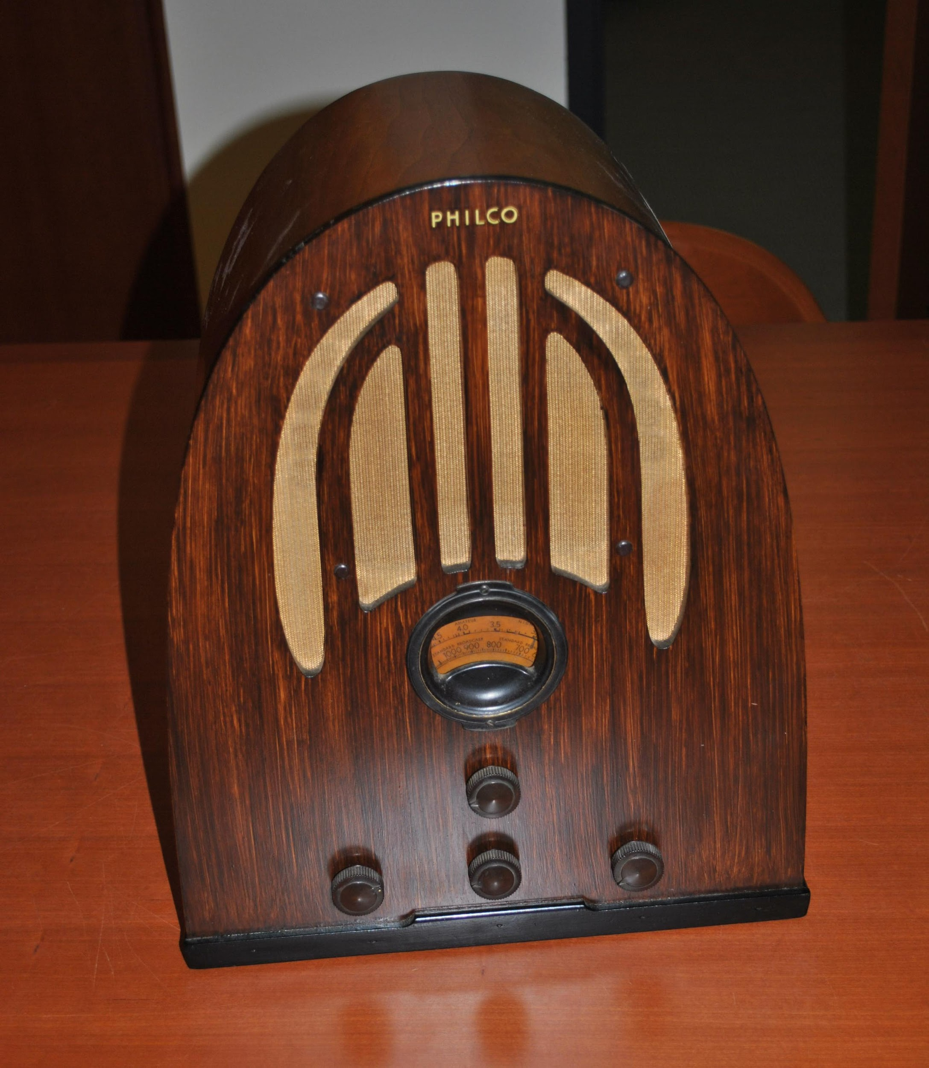
Primary Sources – Objects or artifacts
Artifacts can be an important complement to text-based primary sources because they provide a concrete, tangible dimension to your evidence.
An artifact becomes almost meaningless when taken out of context.
Ask the same types of questions as you would ask when working with other types of primary sources, such as who created the object, did s/he have a particular viewpoint or objective, etc.
An artifact provides insight into the customs, preferences, styles, special occasions, work, and play, of the culture in which it was created.
Notes:
Objects can inform about specific time periods. For example, radios were one of the main forms of entertainment during the Great Depression. Radios influenced peoples’ daily lives. You can make comparisons to how smart phones influence our lives today.

Slide 18
What is a secondary source?
A secondary source is something written about a primary source.
Secondary sources are written after the fact – that is, at a later date.
Usually the author of a secondary source will have studied the primary sources of an historical period or event and will then interpret the evidence found in these sources.
You can think of secondary sources as second-hand information.
Notes:
Secondary sources interpret and analyze primary sources. They are often removed in space and time from the event they are discussing.

Slide 19

What is a secondary source?
Think about it like this….
If I tell you something, I am the primary source. If you tell someone else what I told you, you are the secondary source.
Secondary source materials can be articles in newspapers, magazines, books or articles found that evaluate or criticize someone else's original research
Notes:
Examples of secondary sources include: textbooks, journal articles, documentaries, magazine articles, histories, criticisms, and commentaries.

Slide 20
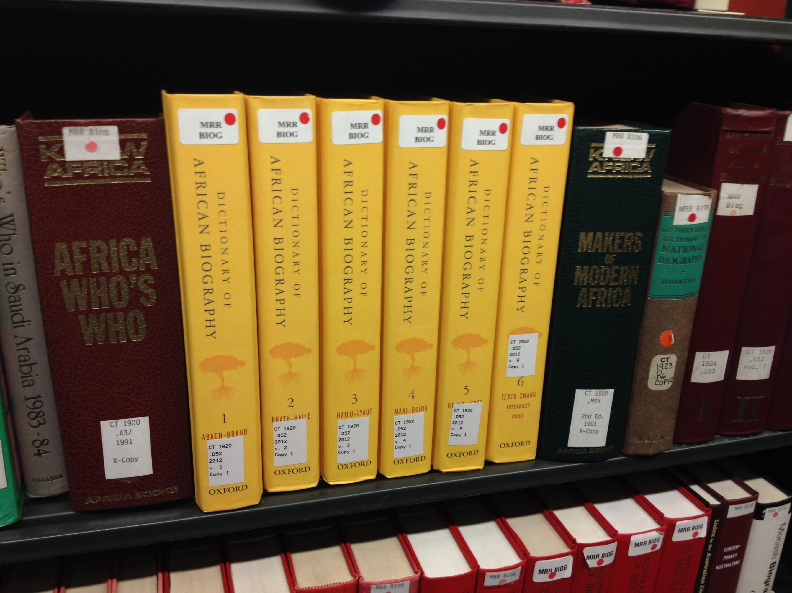
Secondary Sources
Almanacs, encyclopedias, history books (textbooks), etc. are all secondary sources because they were written after the these events occurred.

Slide 21
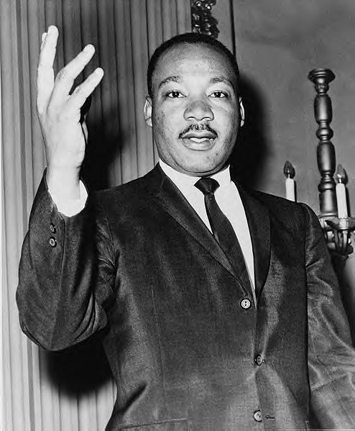
Secondary Sources – Biography
Example: A biography is when you write about another person’s life. Alice Fleming wrote a biography on the life of Martin Luther King, Jr. This is a secondary document. It was written about King after he died.

Slide 22
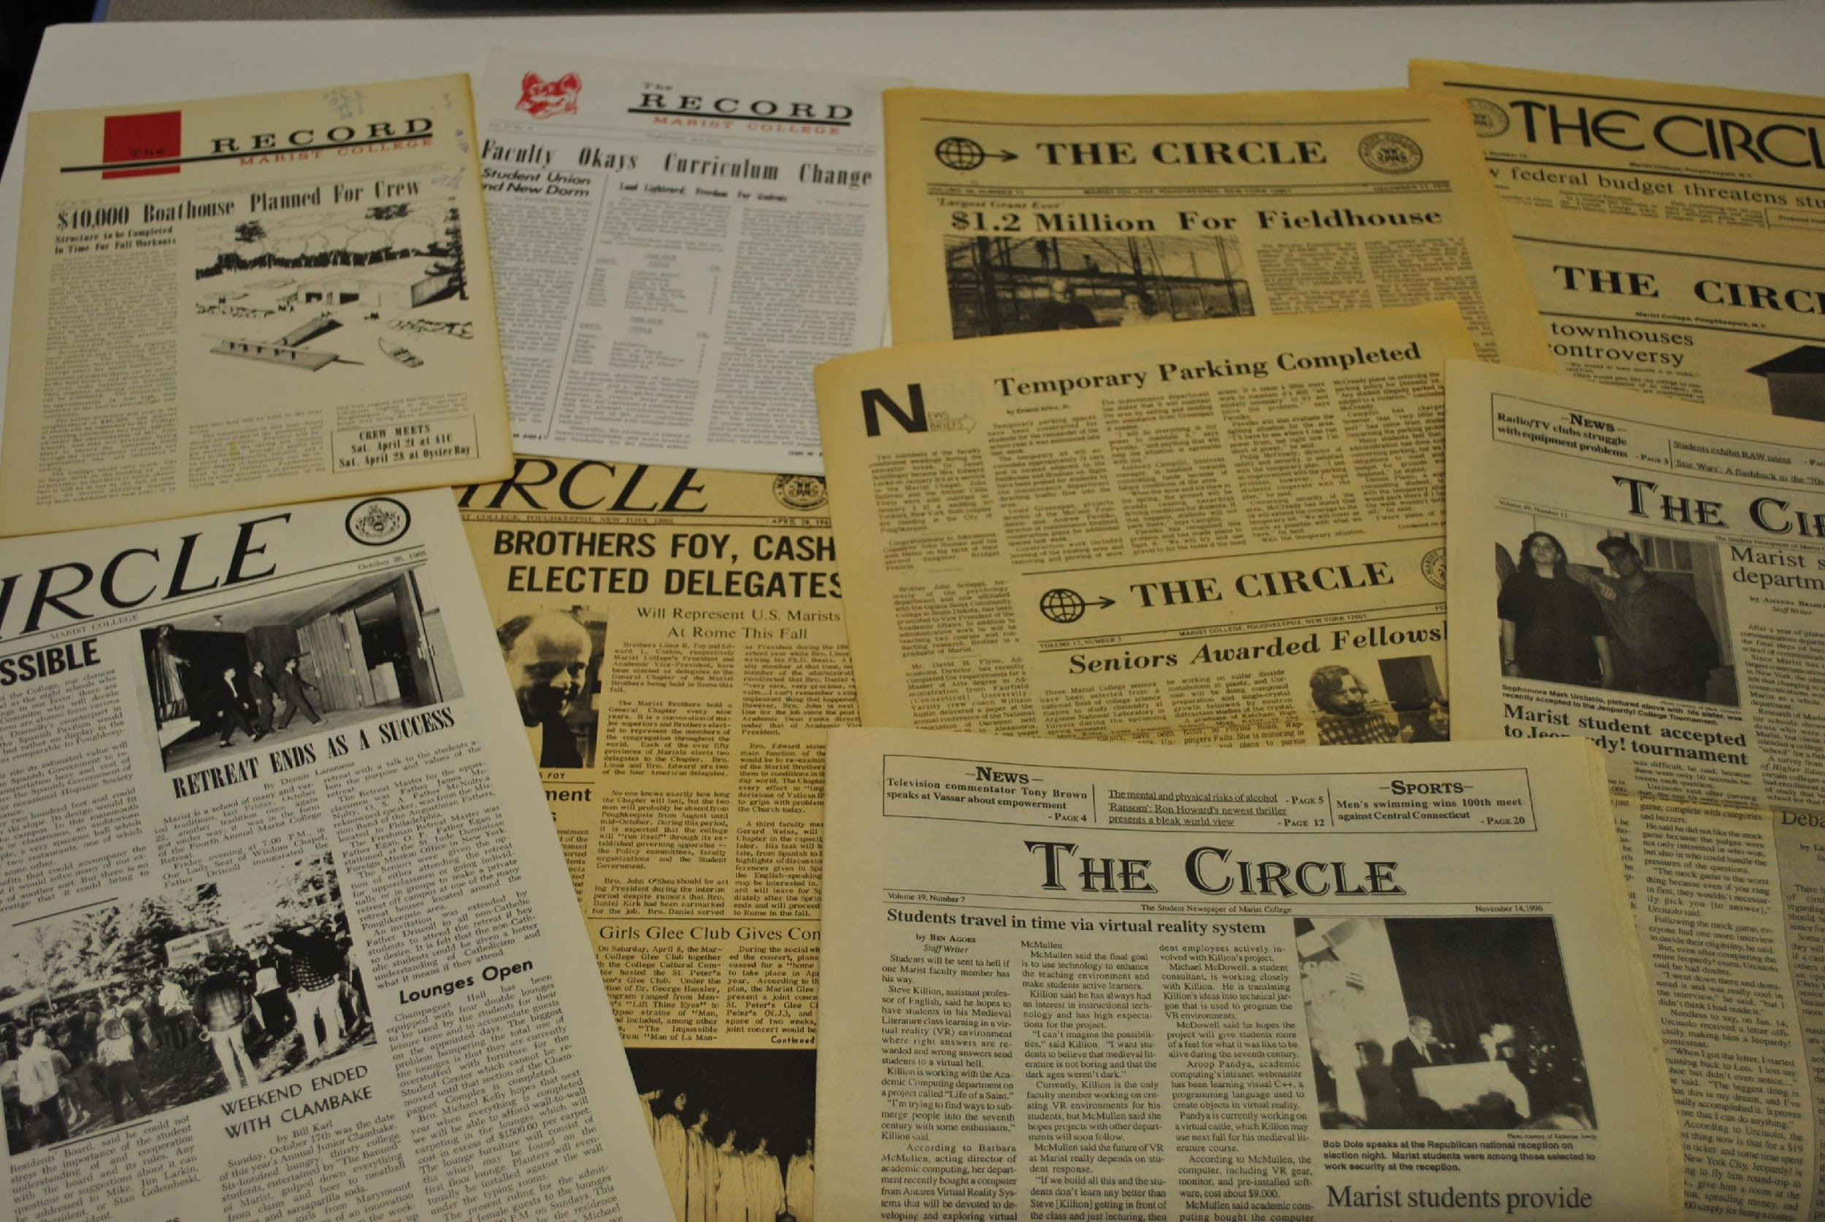
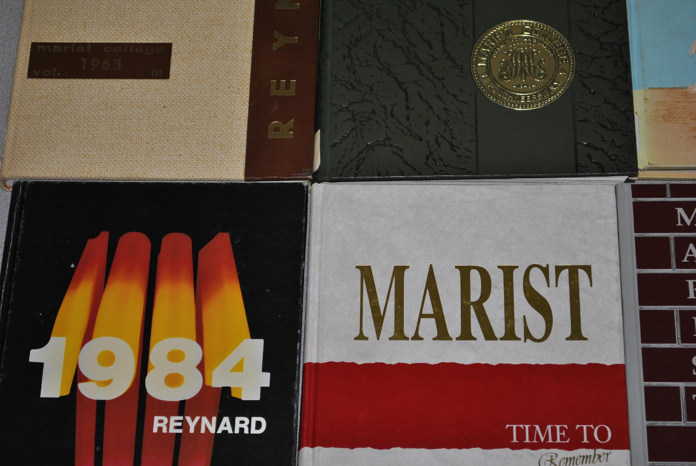
Gray areas – Can a secondary source also be a primary source?
Notes:
There are examples of sources that can be primary or secondary, depending on how they are used. A collection of Shakespeare’s plays could be a primary source, if you used them to research what he was doing during specific times in his life. (Scholars have done just this type of research.) But, his plays would be considered secondary resources, if you were using them as part of a study on English playwrights.

Slide 23
Primary or Secondary Sources?
Newspaper and Magazine articles can be a primary or secondary sources.
If the article was written at the time something happened, then it is a primary source.
Example: The articles written on Barack Obama’s inauguration in 2009 are primary sources.
However, if a reporter in 2009 wrote about George Washington’s inauguration using information written by someone else (1789), that would be a secondary source.
Notes:
Primary sources can be published or intended for wide audiences. Think about reporters writing articles based on their first-hand experiences of an event. The New York Times dates back to the 1860s, when the Civil War was taking place. An article about a reporter’s account of the Battle of Antietam is a primary source, even though it was published in a major newspaper.

Slide 24
Why Use Primary Sources? Advantages
Primary sources provide a window into the past – unfiltered access to the record of artistic, social, scientific and political thought and achievement during the specific period under study, produced by people who lived during that period
These unique, often profoundly personal documents and objects can give a very real sense of what it was like to be alive during a long-past era.

Slide 25
Primary Sources – Disadvantages
Questions of creator bias, purpose, and point of view may challenge students’ assumptions.
Primary sources are often incomplete and have little context. Students must use prior knowledge and work with multiple primary sources to find patterns
In analyzing primary sources, students move from concrete observations and facts to questioning and making inferences about the materials.

Slide 26
Why Use Secondary Sources? Advantages
Secondary sources can provide analysis, synthesis, interpretation, or evaluation of the original information.
Secondary sources are best for uncovering background or historical information about a topic and broadening your understanding of a topic by exposing you to others’ perspectives, interpretations, and conclusions
Allows the reader to get expert views of events and often bring together multiple primary sources relevant to the subject matter
Notes:
Again, keep in mind that you need to use multiple sources, primary and secondary, when conducting your research. Your goal is to give the most balanced and unbiased account you possibly can.

Slide 27
Secondary Sources – Disadvantages
Their reliability and validity are open to question, and often they do not provide exact information
They do not represent first hand knowledge of a subject or event
There are countless books, journals, magazine articles and web pages that attempt to interpret the past and finding good secondary sources can be an issue

Slide 28
Library Resources vs. the Internet
Library Resources:
Come from reputable authors and publishers
Freely available
Purchased with the majors and minors of Marist in mind
Constantly expanding and improving to meet the needs of Marist’s classes
The Internet:
It is up to you to determine the quality of resource
Notes:
The best thing about the Internet is that anyone can publish anything they want. They worst thing about the Internet is that anyone can publish anything they want. You will find a wide range of primary sources on the Internet. Depending on your research topic, you may want to start your research on the Web. When you start looking for secondary sources, you should begin with Fox Hunt.

Slide 29
Searching the Internet
It is up to you to determine the quality of a resource
Look for author, publisher, and sources
Use limiters when searching
“ “
exclude certain words
keep it simple
gradually add search terms
Use “Ctrl F” to find information within a document
Notes:
Remember, it is up to you to determine the quality of the information you find on the Internet. If you use Fox Hunt, you know that the sources are coming from reliable publishers. If you use the Internet, make sure you can back up why you think you found a good source. Is it from a trusted website or a known scholar? Are there sources listed on the website? Basically, if you are going to use a website in your research, you should find the same characteristics on the website you selected that you would find on a scholarly article. Be ready to justify your choice to your professor.

